Slide 1
PRCS252E - Presentation
By William Butler, Andrew Bellas, goel biju and Vincent Castellani

Slide 2
Introduction
In this presentation, we will be demonstrating various features of all three applications within our system. These three applications are desktop, web, and mobile (Android).
The team members who will be demonstrating are Andrew Bellas, William Butler, Vincent Castellani, and Goel Biju.

Slide 3
Content Outline - Mobile Application
The user stories that will be demonstrated for the mobile app are:
Create an account
Login
View account details
Search for a journey

Slide 4
Content Outline - Web Application
The user stories that will be demonstrated for the web application will be:
Login
View all coaches
Create a new coach record
Edit coach capacity
Delete a coach record

Slide 5
Content Outline - Desktop Application
The user stories that will be demonstrated for the desktop application will be:
Login
Select a shift
View stops
Start a journey
View bookings

Slide 6
Mobile Application Demonstration

Slide 7
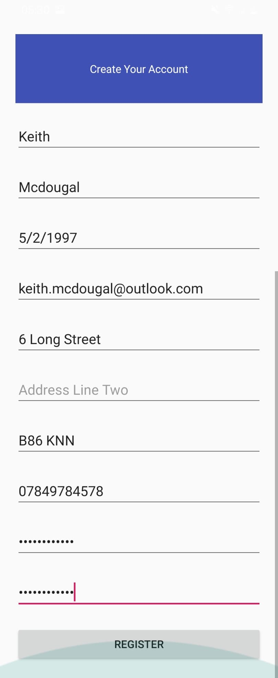
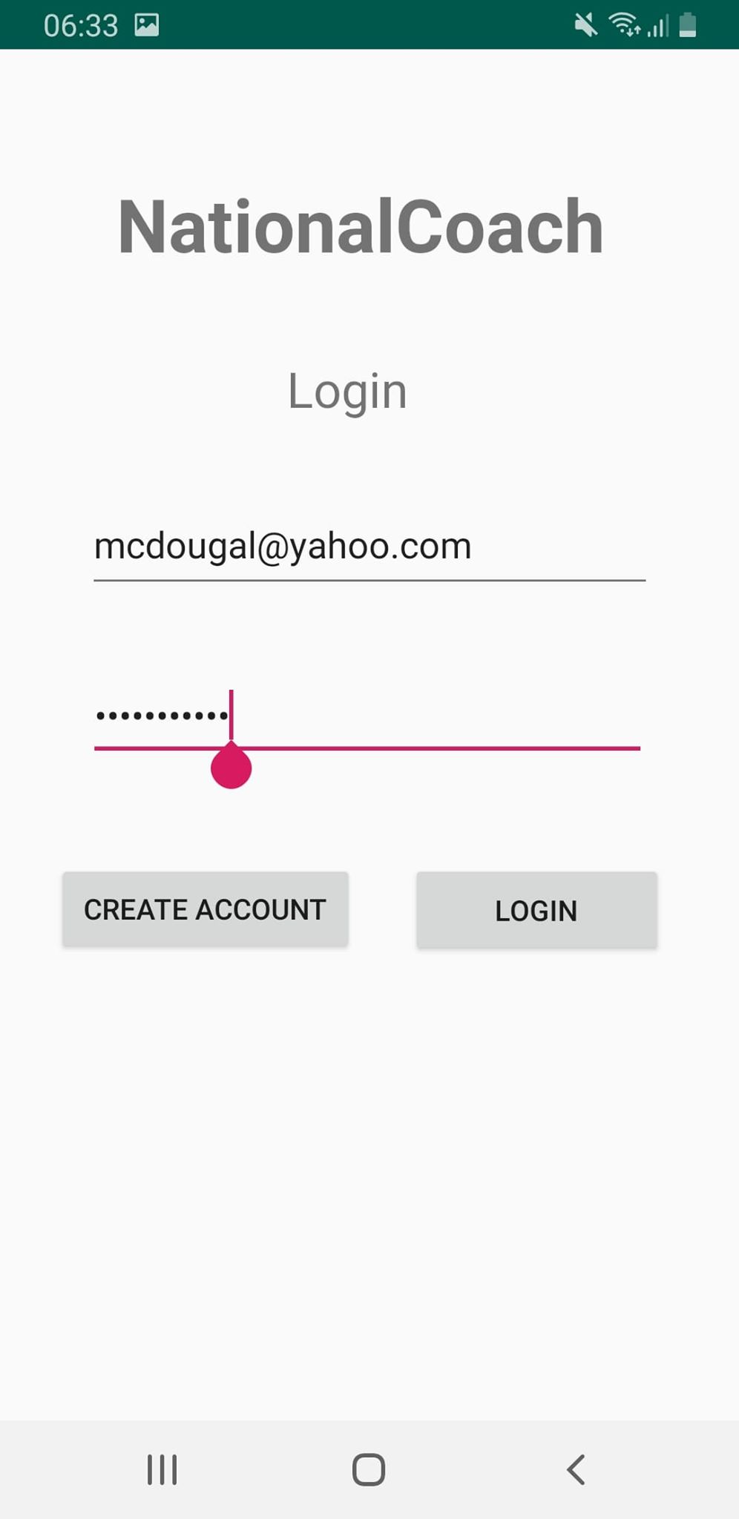
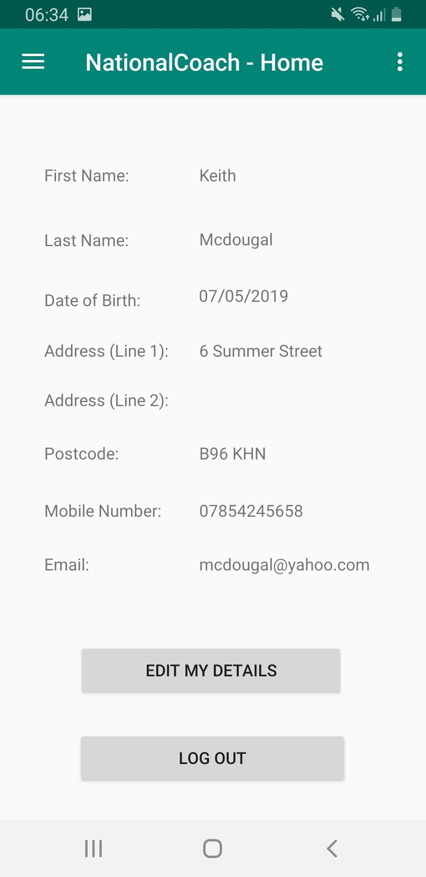
Mobile Application
Create an account
Login
View account details

Slide 8
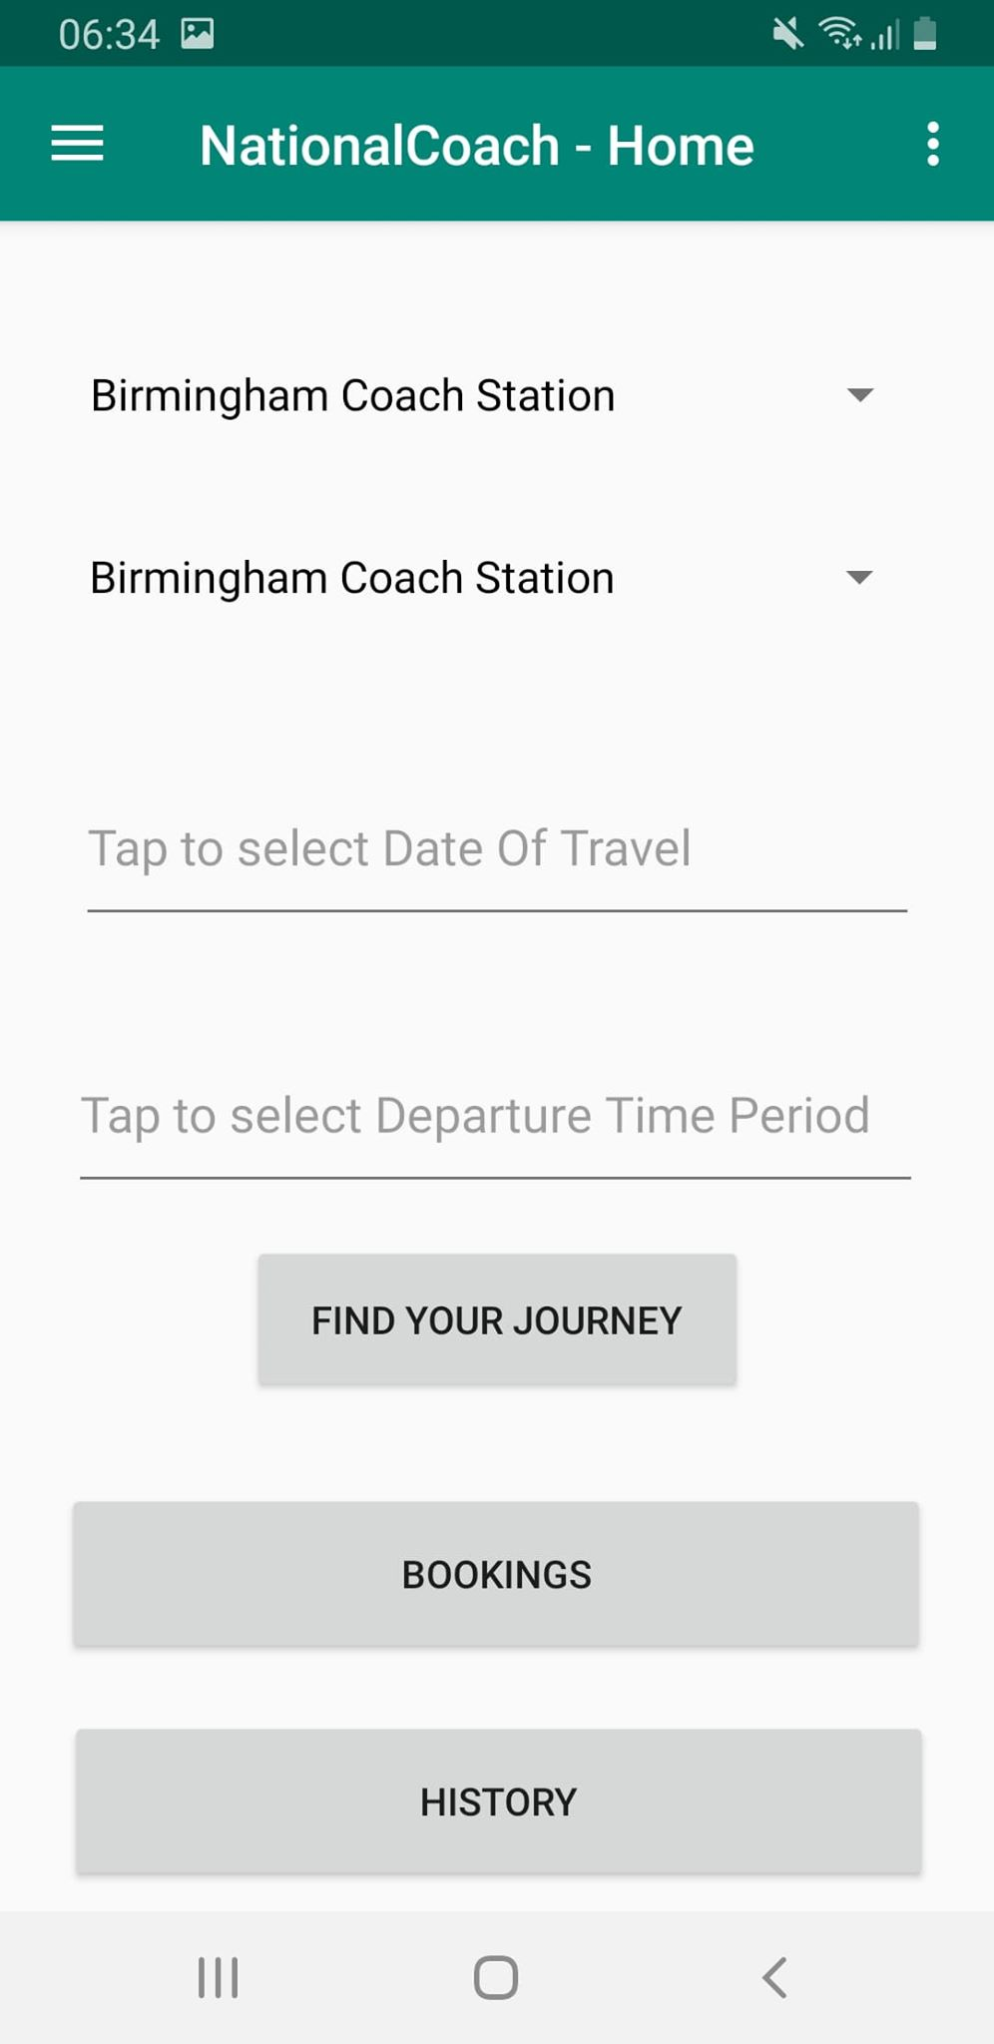
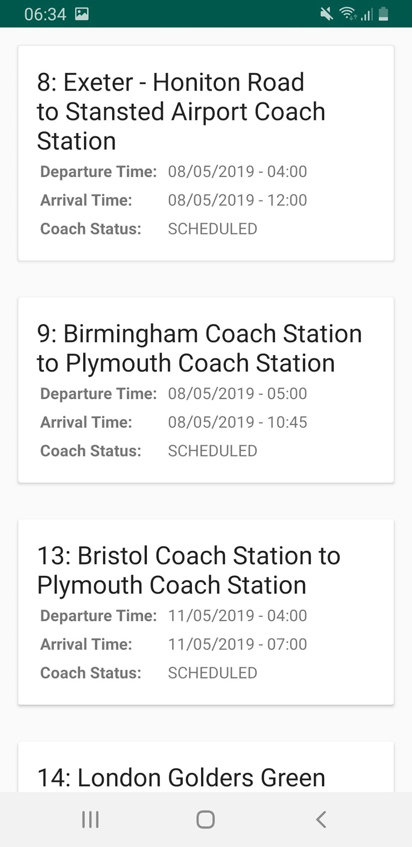
Mobile Application
Search for a journey

Slide 9
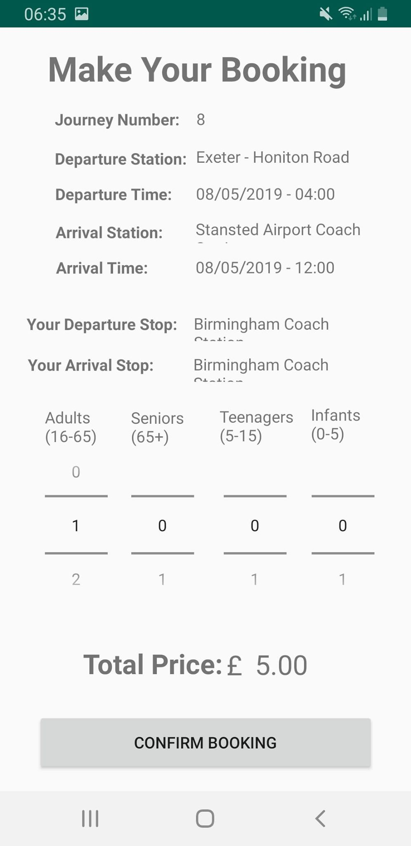
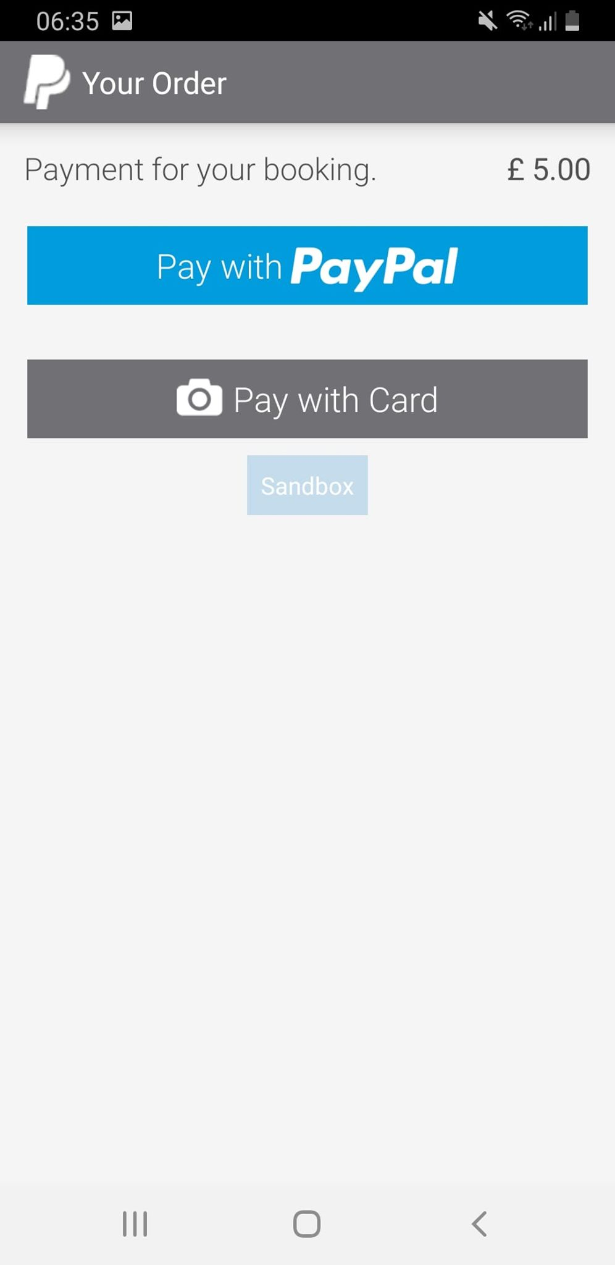
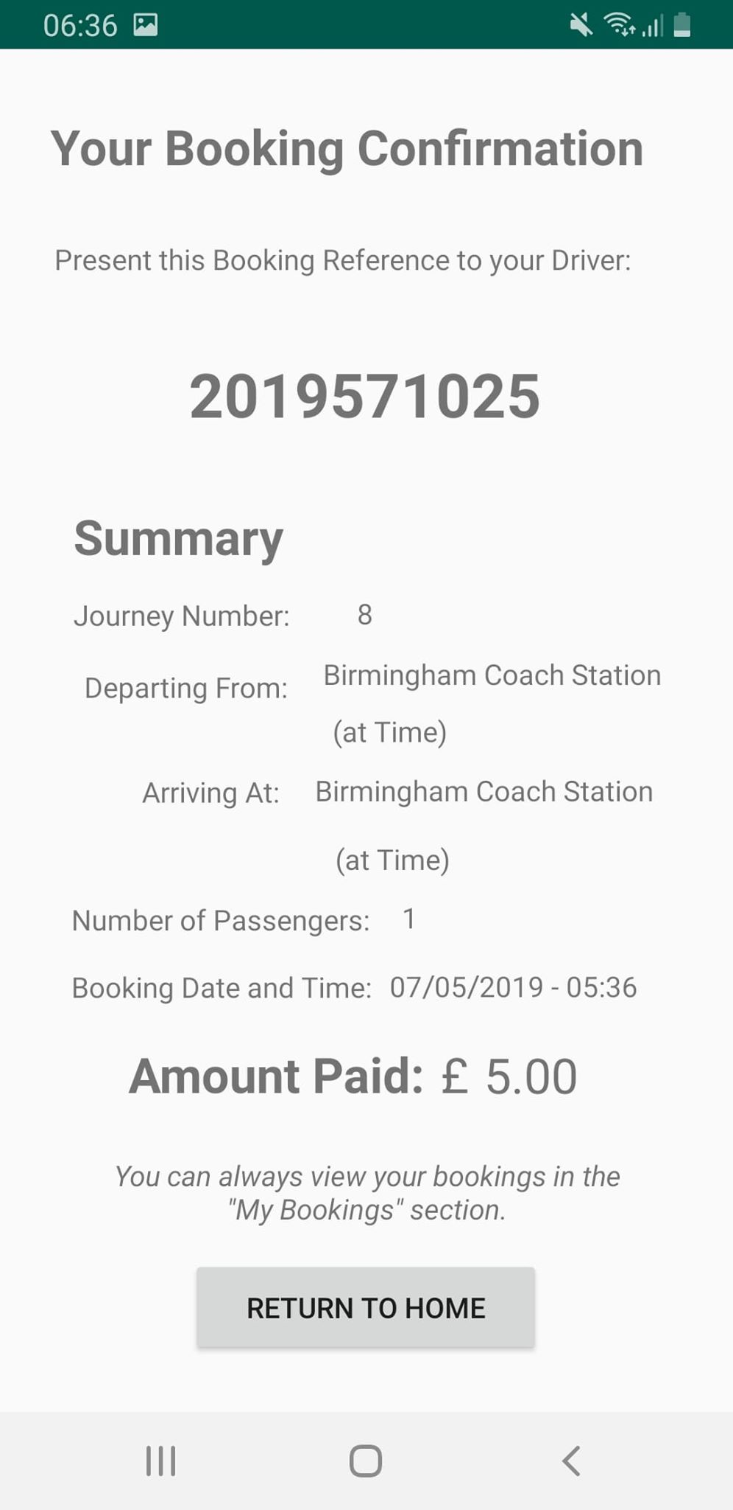
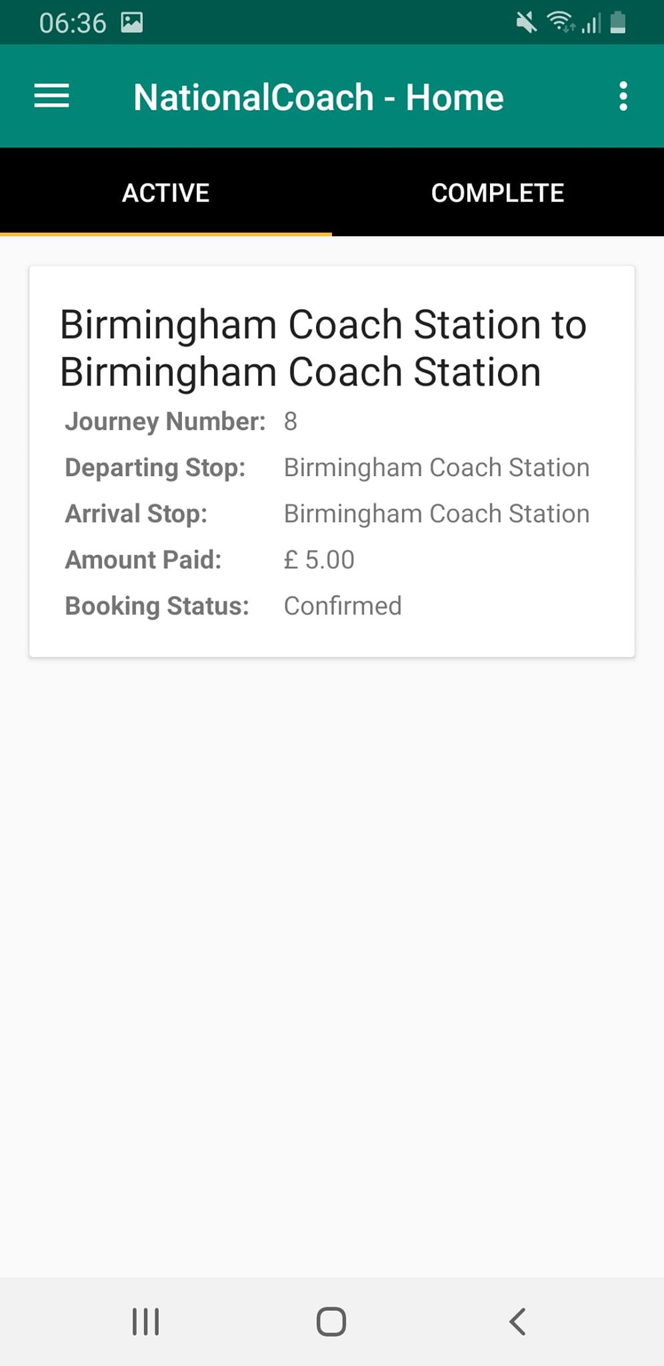
Mobile Application
Book ticket
View booking

Slide 10
Web Application Demonstration

Slide 11
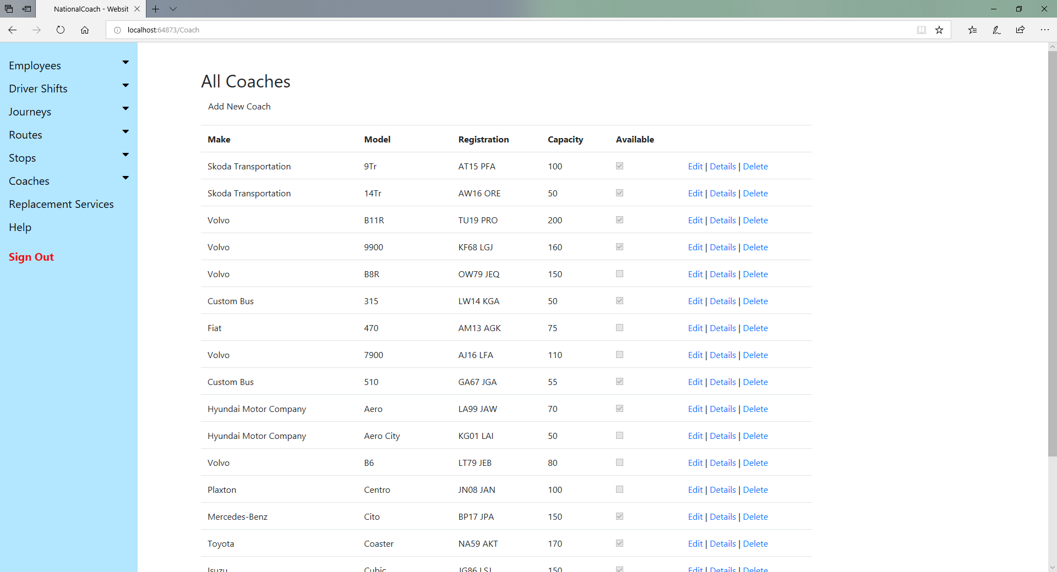
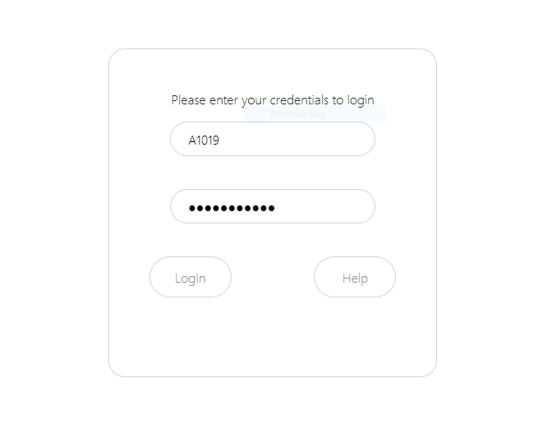
Web Application
Login
View all coaches

Slide 12
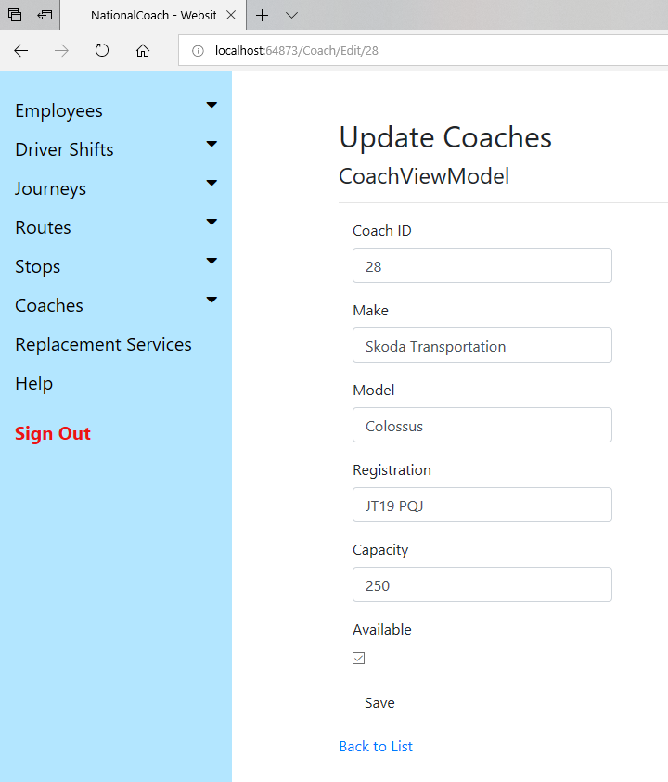
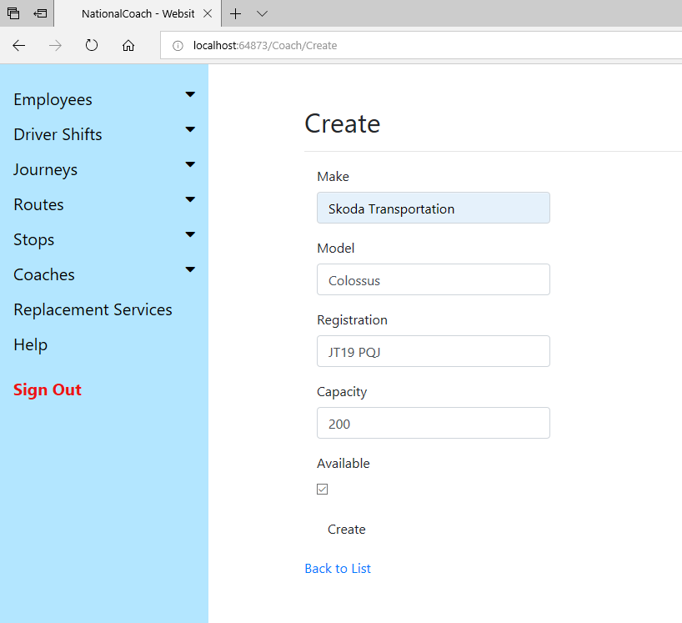
Web Application
Create new coach record
Edit coach capacity

Slide 13
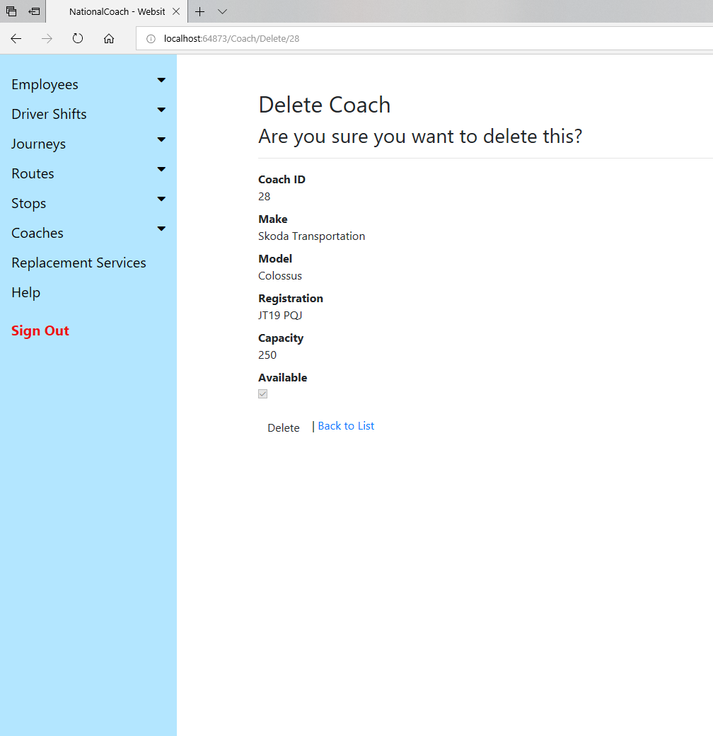
Web Application
Delete a coach record

Slide 14
Desktop Application Demonstration

Slide 15
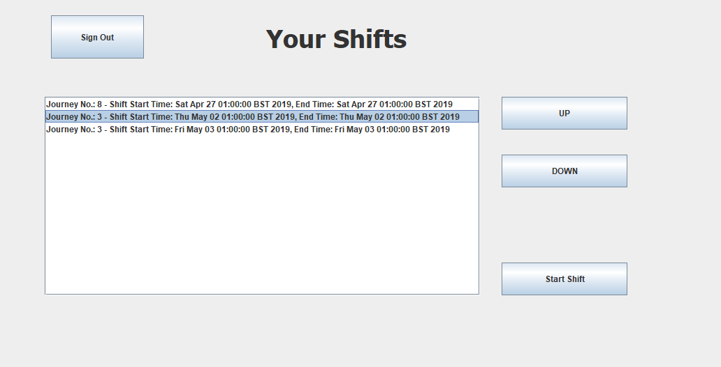
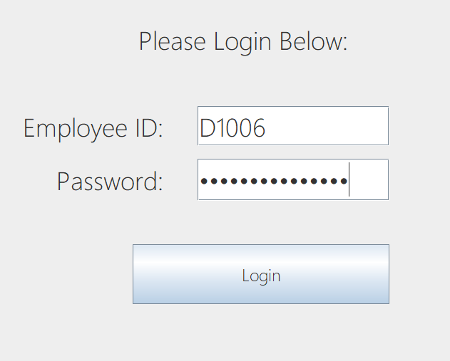
Desktop Application
Login
Select a shift

Slide 16
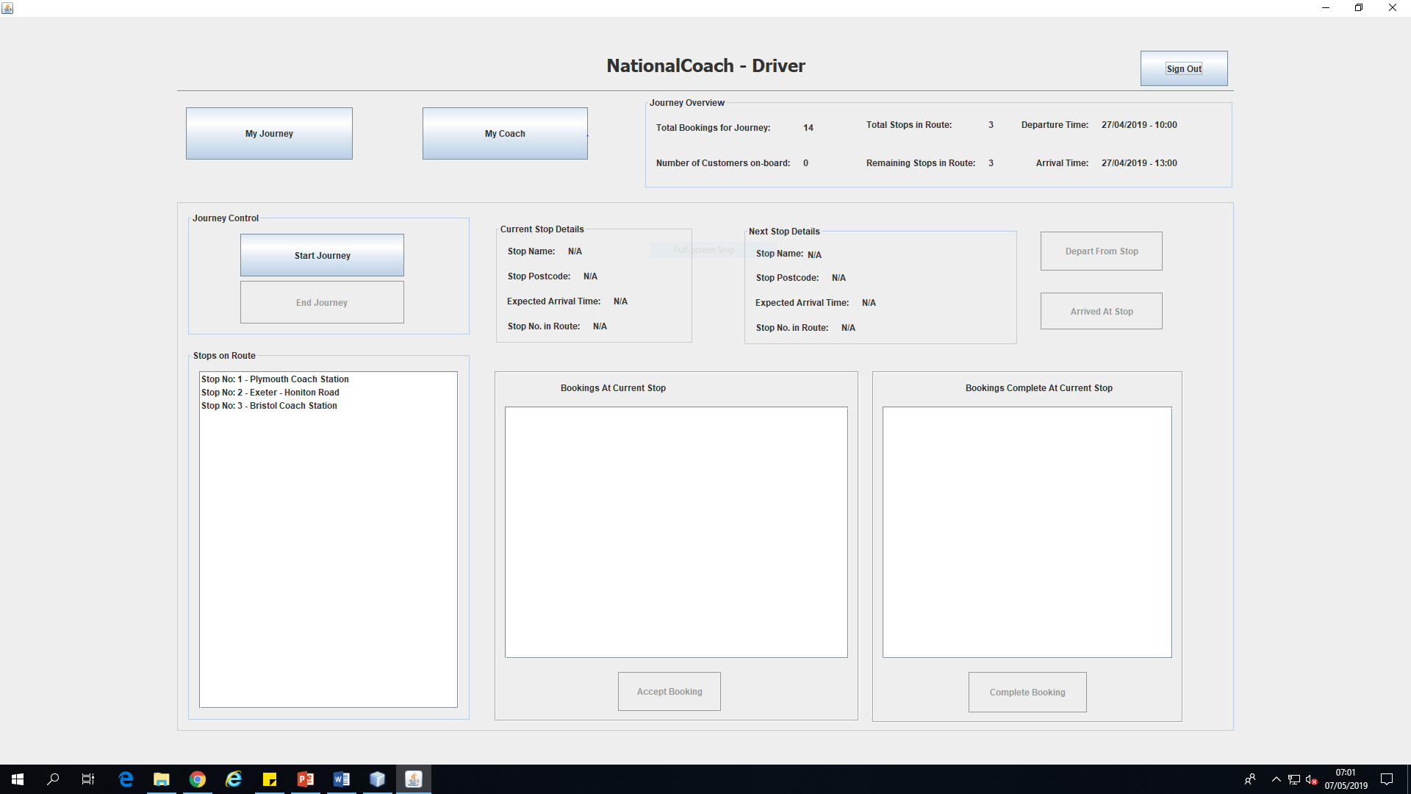
Desktop Application
View Stops

Slide 17
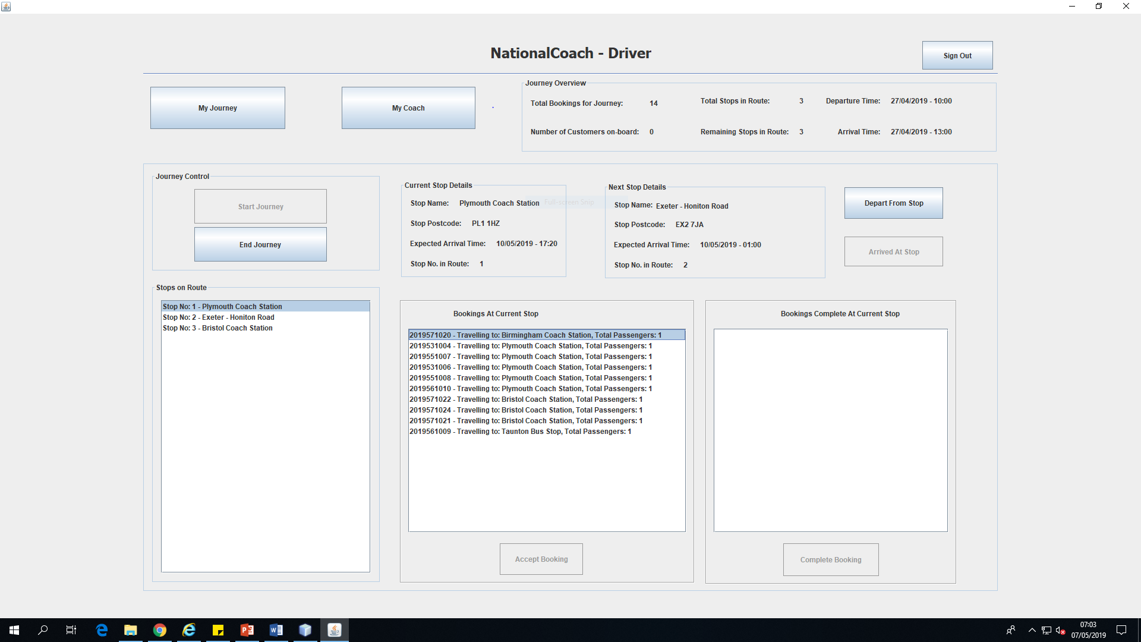
Desktop Application
Start a Journey
View Bookings

Slide 18
Conclusion
To conclude:
Attempts have been made to create full CRUD functionality when and where possible.
HCI has been used in order to benefit the experience of the end user (e.g. large buttons on desktop app for touch screen use, simplistic UI for Android app, easily navigable web app).

